Slide 1
Going Beyond the Blues
Ideas for Improving Beginner Improvisation
OMEA OPUS 100
Nov. 8, 2019
Glenn Waugh
Medway H.S.
Thames Valley DSB

Slide 2
Where we're coming from...
Too basic:
- using the blues scale as foundation
- one-size-fits-all method
- "every note sounds good" - really?
- confidence vs. competence
Too complex:
- attempts to follow "the changes"
- even in simple charts, this assumes a lot
- can bog down a tune tempo-wise
- knowledge vs. ability

Slide 3
The Basic Approach: The Blues Scale (1 - b3 – 4 - b5 – 5 - b7 – 1)
Pros
Cons
Great for the blues, which is a foundational aspect of jazz
Works well in minor keys that feature dominant 7th chords (incl. on the I – chord)
True that all, or most, notes will sound good – over a minor blues
Good to develop rhythm-focused, pattern-based solos with repetitive "licks" or "riffs" as a starting point – great for first-time improvisers
Even this assumes a theory language that is often beyond that of the young improviser - may only know one octave of one major scale – scale degrees, semitones, etc.
Not all blues is minor-blues
Need to be careful with certain notes if it is a major-blues form
Needs careful repertoire planning by teachers – choosing all minor-blues charts, or altering the scale
Breaks down as soon as you exit the blues – major-key, Rhythm changes, or harmonic-minor tunes will all sound "off"
Solos can be choppy and disconnected
Larger leaps and intervals can be hard, esp. for brass pitching

Slide 4
The "Real" Jazz Approach: Chords, Modes, or "Playing the Changes"
Pros
Cons
True that this is the foundation of real jazz improvisation
Introduces students to the idea of chords and how song form works
Helps connect theory lesson information to real-world playing
If successful, solos will sound far more legit and professional
Can connect to transcriptions for analysis of what players are doing on recordings we hear
Introducing the idea of "chord tones" when students likely won't have been introduced to the idea of chords
To do this correctly, need to teach chord construction, arpeggiation, and 7th chords/extensions - fairly advanced for a young student
Want to introduce improvisation early in a young jazz musician’s training – most gr.9-10 students will have limited knowledge beyond (maybe) major and minor scales
Triads are often in senior grades, as are 7th chords (if at all)
Modes have some simpler aspects, but are still a complex concept for a young student to grasp
Assumes private instruction/theory and requires student-driven learning in most cases

Slide 5
Melodic Improvisation "Start where they are..."
Aiming for more linear, melodically-oriented solos
Uses knowledge of major scales as the basis for improvisation, rather than new concepts such as numbered scale degrees with intervallic jumps (Blues) or chord construction (changes)
Reasons are twofold:
1) Familiarity with patterns of the major scale, both under their fingers and in their ears
This familiarity should help with expressive and creative capabilities
2) Eliminates "jumpiness" of the blues scale – esp. fr brass
No gaps in the scale – no intervallic jumps (minor 3rds) to negotiate

Slide 6
Where Do They Need To Be To Start? Two sets of skills are needed:
Mastery of Required Major Scales
not of every scale, or every mode
just the one or two major scales that will “fit” over the original melody (depends on tune)
from memory, with speed, starting on various notes in various patterns
vary based on the age and ability of the students
Knowledge of Chromatic Scale/Semitones
able to play the chromatic scale on their instrument fluidly from memory
most grade 9 students should be able to do this
chromatic scale is necessary because the addition of chromatic passing notes to the major scale is a fundamental quality of linear bebop improvisation

Slide 7
Linear Melodic Improvisation Major Key Tunes
Great starting point – lots of great tunes are based in major tonality
Using a standard major scale is less scary than having to “figure out” something new, such as the pattern of the blues scale, using intervals and unfamiliar leaps
One addition - chromatic passing note at the top of the scale – two 7ths, one major, one minor (flat 7)
Ex. Concert Bb major scale would have both A flat and A natural, creating four chromatic notes at the top of the scale
“The reason for using ½ step chromatic tones is so that the chord tones fall on all the strong beats in a measure. [...] Chromatic tones in the 8th note scale can be thought of as hinge tones. It is important to hinge one scale to another. [...] Using the 8th note scale in this way will provide the much needed line direction, or as sometimes called, “forward motion” in the melodic line.” (Riposo 38)
This idea of forward momentum, or melodic line direction, is the major disadvantage of over-reliance on the blues scale

Slide 8
Exercises with major scales:
1.
Scale
w/2-7ths
2.
Desc.
Exercise
3. Pattern Exercise

Slide 9
Linear Melodic Improvisation Major Key Tunes (cont'd)
Often the entire head of the tune can be improvised on using just this major scale, with the addition of chromatic passing tones leading between chord tones (for example, leading to 3, between 4 and 5, etc.) - this is where knowledge of the chromatic scale comes in
Many American Songbook standards can be approached with this melodic improvisation method
"Fly Me to the Moon" and "Nearness of You" are two examples
Exception is Rhythm Changes (based on Gershwin's "I Got Rhythm" chord changes), where the bridge needs special attention as it uses cycling major scales moving in 5ths – ex. "Oleo" by Sonny Rollins

Slide 10
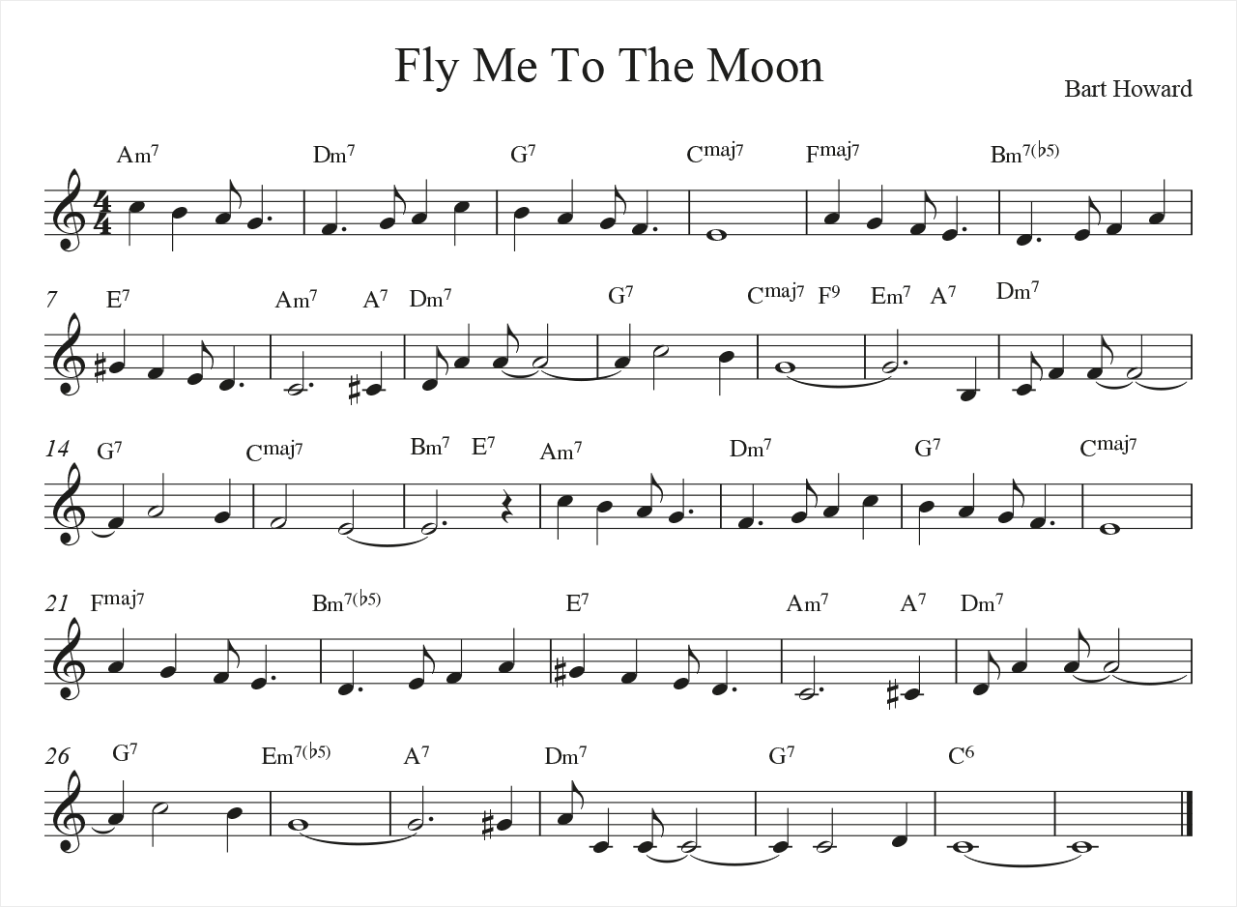
Fly Me To the Moon
Melody is essentially a descending major scale, played 5 notes at a time
Adding chromatic notes allows for greater interest and connective motion

Slide 11
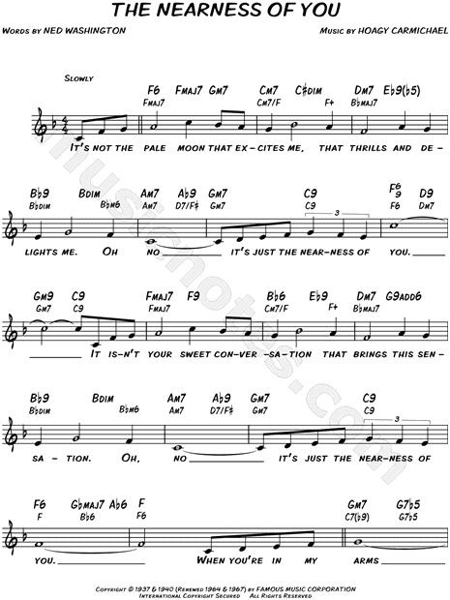
Nearness of You
Again, melody is essentially a major scale played in a pattern

Slide 12
Linear Melodic Improvisation Minor Key and Blues Tunes
Blues scale is still a good starting place
Adding the 2nd note of the scale (or 9th, if you prefer) immediately expands the melodic possibilities for linear improvisation
Works especially well as a 9th in the second octave, after moving up through the blues scale (Coltrane opening lick of "So What" solo)
In the first octave, smooths out the leaps (minor 3rds) of the blues scale
Creates a more traditional minor scale sound on the first 5 notes
Often advisable to still avoid the sixth degree
Experiment with minor 7th and major 7th, depending on the tune
Minor 7th is best on dominant harmonies/blues, while the "harmonic minor" sound of the major/raised 7th fits many more traditional ballads

Slide 13
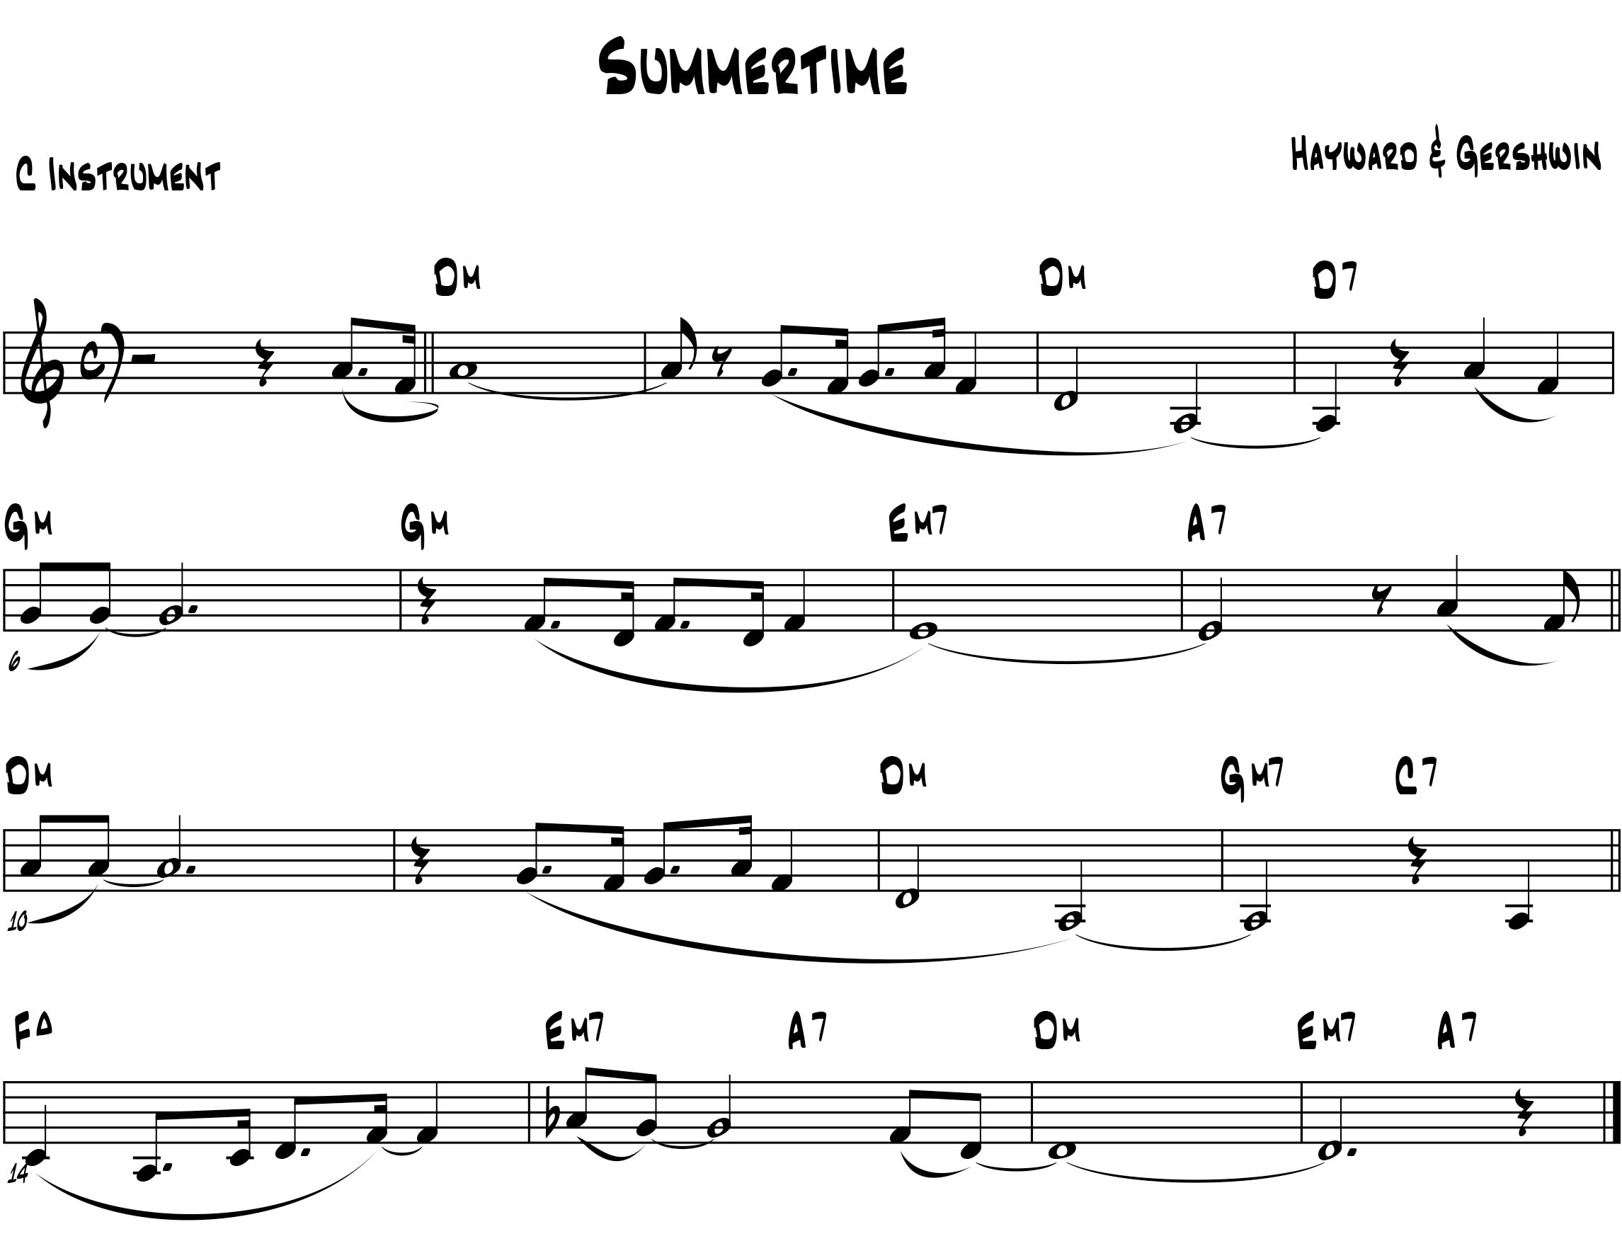
Summertime
Blues scale
Blues scale with added 2nd (in melody)
Blues scale progression up to 9th

Slide 14
Jazz Phrasing To swing or not to swing...?
Slurring rather than tonguing, generally at first – using tongue to delineate phrase, or for accent, but not all the time – avoid choppiness
Swing eighth-notes should be primarily when playing as an ensemble – the "triplet"-feel swing should usually be avoided in solos
When you listen carefully, many improvised solos, especially from the be-bop era forward, are actually played with straight-eighths
"The unique "feel" in jazz improvisation comes from the tension between the swung-eighths in the rhythm section against the straight-eighths in the improvised solo" (Andrew Scott, Associate Dean of Music, Humber College)

Slide 15
Jazz Phrasing To swing or not to swing...?
Oleo - Miles Davis - Bags' Groove version
Pent-Up - House - Cifford Brown and Sonny Rollins
Joy Spring - Clifford Brown
Jordu - Clifford Brown
Look for the Silver Lining - Chet Baker (Last Great Concert)

Slide 16
Jazz Phrasing "Backphrasing"
Bebop slur pattern of tonguing the off-beat, slurring into the beat when playing eighth note scalar patterns
Takes a lot of time – work on scale patterns with this articulation
Avoid clipping the second note – don’t want choppy, needs to remain smooth at the back end of the slur
NOT GOOD

Slide 17
Jazz Listening Considerations
Too often we direct students to artists, without considering the need to direct them to specific albums, tunes, or eras of that artist
"Trumpet players should listen to Miles Davis" (Great – Bitches Brew? Doo-Bop? Probably not...but earlier Miles Davis is far more accessible and mimic-able) "and Maynard Ferguson" (amazing – but is there a point to a grade 9 spending a lot of time listening to that, when their range is one octave, beyond inspiration? May even instill bad habits if trying to mimic without the requisite building blocks and process work)
"Sax players should listen to Coltrane" (need to be specific – probably earlier stuff, more mainstream – only the more musically advanced will be able to deal with more experimental works, which are the bulk of his more celebrated recordings) "and Charlie Parker" (if I’m a grade 9 alto player, this would seem both excessive and impossible – maybe inspirational, but also might turn them off)

Slide 18
Jazz Listening Considerations (cont'd)
Need to be very specific with listening advice
Find legit jazz recordings/artists/albums, but that have an attainable aspect to them – something they can emulate at their own level
Amazing stuff is amazing, but is so far out of the realm for most kids that it is far more an inspiration than a model
Doesn’t need to be instrument specific –good to have models for tone, etc. but for style, phrasing, ideas, instrument matters much less than we think –
Doesn't have to be SLOW, but need to start with simpler, melodic improvisation rather than complex, outside-the-box playing

Slide 19
Jazz Listening Considerations (cont'd)
Often the early recordings, etc. by an artist are more attainable
As well, some of the "second-tier" players tended to stay more "in-the-box" than their more innovative counterparts, making their recordings more accessible throughout their careers (Kenny Dorham, Art Farmer, Joe Henderson, Benny Golson)
Some Albums to Check Out for Improv Style
Miles Davis – Best of the Capital/Blue Note Years
Miles Davis Quintet – Cookin', Relaxin', Workin', Walkin'
Chet Baker – Best of Chet Baker Plays and Sings, Last Great Concert
Art Blakey Jazz Messengers – Night at Birdland, Café Bohemia, self-titled
Clifford Brown and Max Roach – album on Verve, At Basin Street
Sonny Rollins – Sonny Rollins +4

