Slide 1
Introduction to Classical Indian
Vocal Technique &
Music Theory
Presented by Shobha Shekhar
At the OMEA OPUS Conference
9th Nov 2019

Slide 2
Indian Vocal Technique & Music Theory
Welcome Address and Introduction
Good Afternoon & Welcome!!
Personal introduction
Brief explanation of my profile

Slide 3
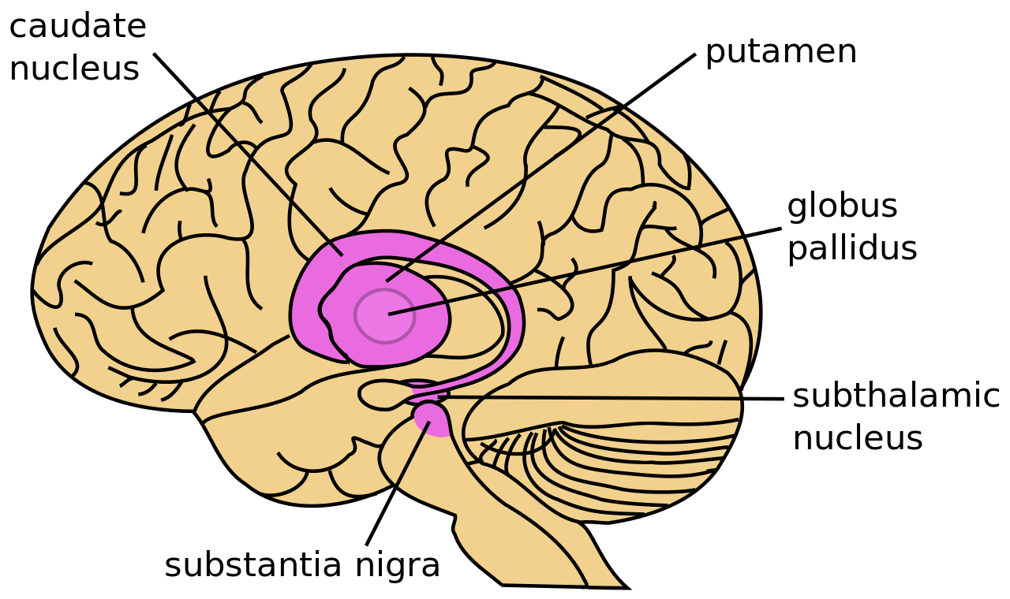


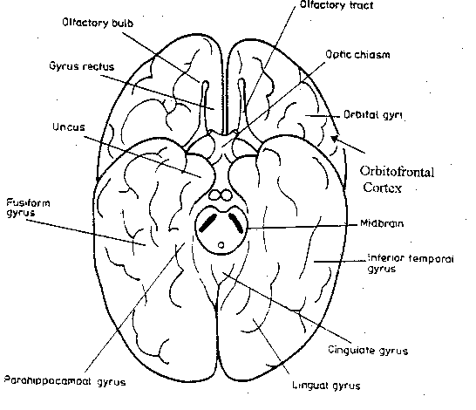

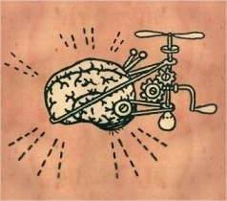





Music
OMEA OPUS Conference 9th Nov 2019

Slide 4
Indian Vocal Technique & Music Theory
Indian Classical Music is divided into two prominent Styles
  The Northern Classical music – Hindustani classical
  The Southern Classical music - Carnatic Classical
  Today we will talk about Hindustani Classical music and its various styles of presentation and other relative Genres.
The Northern Classical Music : Hindustani Music
  The founder or the father of this style of music was Amir Khusrao, in the 1300 to 1500 centuries, during the Mughal Era.
  Ancient music deeply influenced the spiritual power of music, which led to the birth of the Indian classical music
  Classical music uses three basic elements for any song compositions
    a Melody, Rhythm and Harmony

Slide 5
Indian Vocal Technique & Music Theory
All of these notes used in a various styles and format in a theme becomes a melody, when these notes are arranged in a specific way so as to emphasise the use of the notes and its variety.
At the beginning of each lesson the notes in a particular Raaga are taught in an ascending (Aaroah) and descending ( Avroah)format.
Every Raga has one or two prominent note, which is called the vadi or the samvadi swar(note) and is used in the compositions to exemplify the theme of the raag and the composition
When these notes are grouped together in a singable format, this arrangement within this framework is called the Raag challan
There are hundreds of ragas and they usually get their names by the notes structure used, the scale or are offshots from the many pure ragas composed where there is a slight diversion from the pure scales or notes used.
Examples of Raagas in its pure format: Bhairav, Bhimpalasi, Durga, Bhoopali, Desh
Examples of Mixed Raagas which are offshoots of some of the above raagas are mishra Todi, Mishra Bagashree
For eg : Raag Yaman is usually called the mother of all Raagas and also taught to students as their first lesson after they practice and master all of the seven notes during their initial music lessons.

Slide 6

Indian Vocal Technique & Music Theory
Vocal Technique
In the previous slides you learnt about ascending and descending notes, Raaga and the its varieties…
Lets learn what notes are and how are they sung.
Musical notes – Indian vs Western
Do, Re, Mi, Fa, Sol, La, TI . Do - Western – A Demo
How to voice train : Techniques

Slide 7
Indian Vocal Technique & Music Theory
The Root Note and the use of these notes to train the vocal chords
youtu.be/lVYBVir9Ukw
Indian classical music has 12 notes including the root notes from the singing octave
The Root note is SA and the other note progressions and patterns as under
Sa, Re, Ga, Ma, Pa, Dha, Ni, Sa
Sa, Re,re,Ga,ga,Ma,Ma, Pa, Dha,dha,Ni,ni,
Saa – Next Octave – Higher
Sa Re Ga Ma Pa Da Ni Sa – Indian version of how to sing notes - A Demo
https://youtu.be/K9TaGnr2Rfk – Scales

Slide 8
Indian Vocal Technique & Music Theory
Understanding the Hindustani classical music presentation style will be a bit more easier and simpler to explan with an insight of the notes and its use in the various raaga, Largely this style of music is presented in 4 parts, lets see what these are
Raag Vistar : The notes of the raaga
Vilambit Khayal ; this is usually a short 2 or 4 line ode that is sung in a 16 or 32 beat format to
Bandish (short song) is the second lesson, where a short composition is used to further exemplify the raaga.
Tarana – The final presentation, is a type of composition in hindustani classical vocal music in which certain words and syllables (e.g. "odani", "todani", "tadeem" and "yalali").
These were inculcated from Persian and Arabic phonemes are rendered at a medium (madhya laya) or fast (drut laya).

Slide 9
Indian Vocal Technique & Music Theory
North Indian music also is used to represent various genres like the ones below
Ghazals :
Ghazals are normally poetry’s that are used in a song format based on a pure raag or a mixed raaga.
Sufi :
Sufi music was inculcated by the islamic faith who used the genre to offer prayers to the almighty and soon gained lots of popularity and hence found its way into many theatres, studios and performance platforms
Bollywood :
This form of music covers and includes various styles like the hiphop, rock, cabaret, classical etc
Devotionals : are short compositions used to sing hymns, shlokas and other spiritual music.

Slide 10

Indian Vocal Technique & Music Theory
Music & Meditation & Therapy
Playing music, listening to music, singing or playing an instrument helps our motor skills and cognitive functions, ease stress and live a better
The various section in our brain controls our brains activity, each nerve is used as a transmitter and connectors that speak to each other and perform it routine activity, thus it is considered to be an important organ that needs constant nutrition and variety of these.
So other than food nutrition and other drug therapies, music tis also considered an intervention therapy that is used widely in the treatment of many ailments and disorders as it :
Promote emotional health
Promote our cognitive functions
Help patients cope with stress, and boost psychological well-being.
Relieve Stress, relax the mind, energize the body, and even help people better manage pain
Meditation : A Demo
https://youtu.be/a29jzOHwwq0 with OM
https://youtu.be/cdB-qv4YXoY - Relaxing music and its effects

Slide 11
Indian Vocal Technique & Music Theory
Q & A

Slide 12
THANK YOU
Indian Vocal Technique & Music Theory

