Slide 1
Chamber Music in the Strings
Classroom
Presented by Megan Benjafield
on behalf of the Ontario Strings Association

Slide 2
Why Chamber Music?
Musical Skill Development
Community and Team Building
Social / emotional Skill Development

Slide 3
Musical Skills Development
Ear Training / Intonation
Playing autonomously in an ensemble
Score reading
Ensemble Skills: balance, blend, phrasing
Non-verbal communication: cueing, following, watching

Slide 4
Community And Team Building
Problem solving
Communication skills
Relationship building
Compromise
Self-awareness

Slide 5
Socio-emotional Skills Development
Student Centric Learning
Leadership
Self-confidence
Interpersonal Skills
Autonomy
Conflict Resolution
Focus

Slide 6
Setting Yourself Up for success

Slide 7
Logistics
Space
Time
Make up of ensembles / unbalanced instrumentation
Choosing music

Slide 8
Introducing Chamber Music
Group Work Discussions
Approaches to Practicing
Historical Purpose of Chamber Music
Notes:
Approaches to Practice: We always assume that kids understand how to practice, but it is a learned behaviour. We have to teach them what is expected in chamber music, that they will count together, that they should rehearse in chunks

Slide 9
Non-Verbal Communication
Whole class warm up games
Mirror game
Cue / counter cue
Follow the leader
Steal the lead

Slide 10
Rehearsal Strategies
Multiple groups on same piece
Doubling up: why and why not?
Set a goal for the rehearsal
No such thing as done

Slide 11
Repertoire Recommendations
With our thanks to Long and McQuade,
all of the recommended repertoire will be available in their industry booth during the conference.

Slide 12
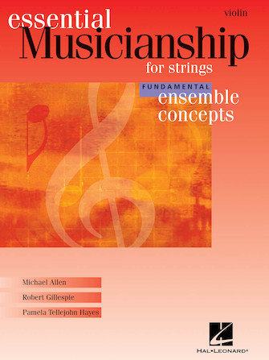
Repertoire Recommendations
Essential Musicianship
Available in fundamental and
intermediate levels.
Compliments Essential Elements
method books, but can be used as
a stand alone.
A, B and Cello / Bass parts.
Published by Hal Leonard

Slide 13
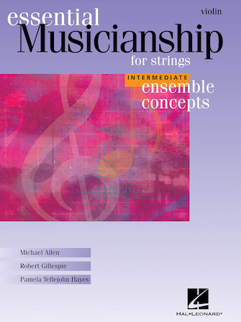
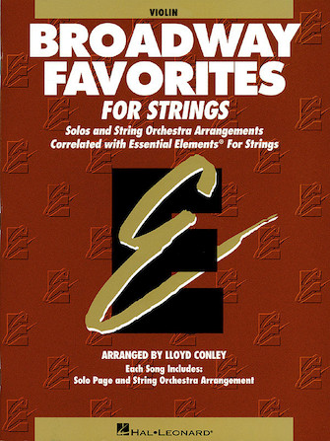
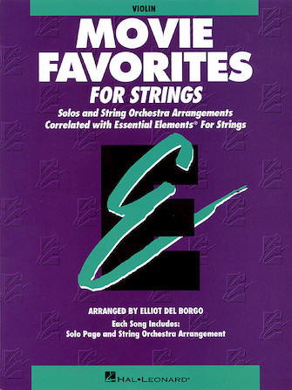
Repertoire Recommendations

Slide 14
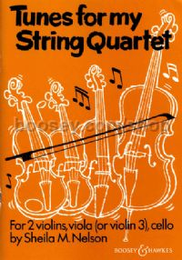
Repertoire Recommendations
Tunes for My String Quartet
Compiled / arranged by Sheila M. Nelson
Full of popular light classical piece
Intermediate or advanced beginner
Has violin 3 option
Series of books also includes
Quartet Club 1 and 2
Boosey and Hawkes

Slide 15
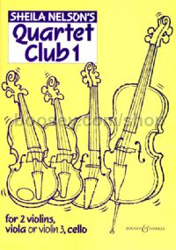
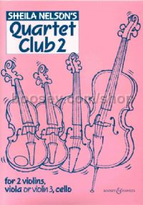
Repertoire Recommendations

Slide 16
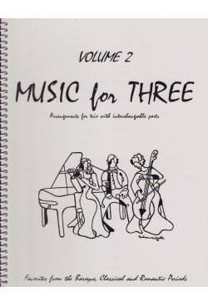
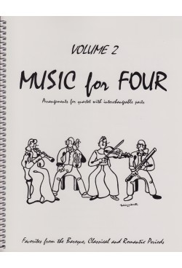
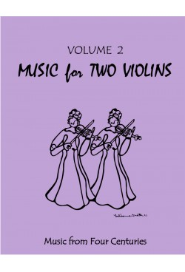
Repertoire Recommendations
“Music For _____” Series

Slide 17


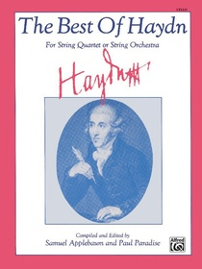

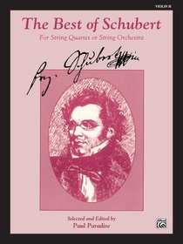

Repertoire Recommendations
The Belwin / Alfred “Best of ______” series of string quartet books.

Slide 18
Repertoire Recommendations
No Budget?
Use past string orchestra charts, one per part.

