Slide 1

Inclusive Singing within our Classrooms
Some Vocal Findings Through my Vocal Fold Study of Students with Williams Syndrome, Autism and Down Syndrome

Slide 2
The Modern Day Vocal Class
Students with varying exceptionalities; both vocal and physical.
The importance of proper breathing while NOT singing
Our goals of musical inclusivity verses our reality

Slide 3
My Vocal Journey into Williams Syndrome
Williams Syndrome: What is it?
How it affects Vocal Folds
12 Year Study of Trial and Error
The vocal observations and similarities between Down Syndrome
Vocal Techniques that can be applied in the classroom.

Slide 4
Some Strategies
Become a breathing specialist when NOT singing
Become a tongue detective while students are singing
Some Vocal Techniques to try with students.
The importance of “No Bubble” Space.

Slide 5
Vocal Techniques
The importance of finding our Vocal Resonators
  1. Posture; How to check and correct easily
  2. Techniques to open our “higher note” resonator
  3. Finding a clear tone
  4. Expanding our vocal range
  5. Small movements translate to big results
  6. Collaborative Ideas

Slide 6
Tongue Placement
Observations of the tongue and tongue placement in students
Singing and speaking Lisps
  Definition according to Toronto Speech Therapy:
    “A lisp is a consistently mispronounced sound that is caused by a misplacement of the tongue during speech. Lisps can be divided into two types: frontal lisp and lateral lisp. With frontal lisps, the tongue placement is too far forward creating a "th' sound where the /s/ and /z/ sound should be.”
- Mirroring Techniques to find proper placement.

Slide 7
Using our WHOLE Instrument
  Painting Our Voices
  Clapping while Singing;
    How to ‘appear’ like we can keep the beat while singing.
  Visual Movement
  Using SOLFEGE
    The benefits of Solfege Techniques in non-verbal students
    Using our “elevators”

Slide 8
“Caring Voices”
How this vocal group began
Philosophy of Caring Voices
Community Outreach
Everyone has value and can connect
Future goals

Slide 9
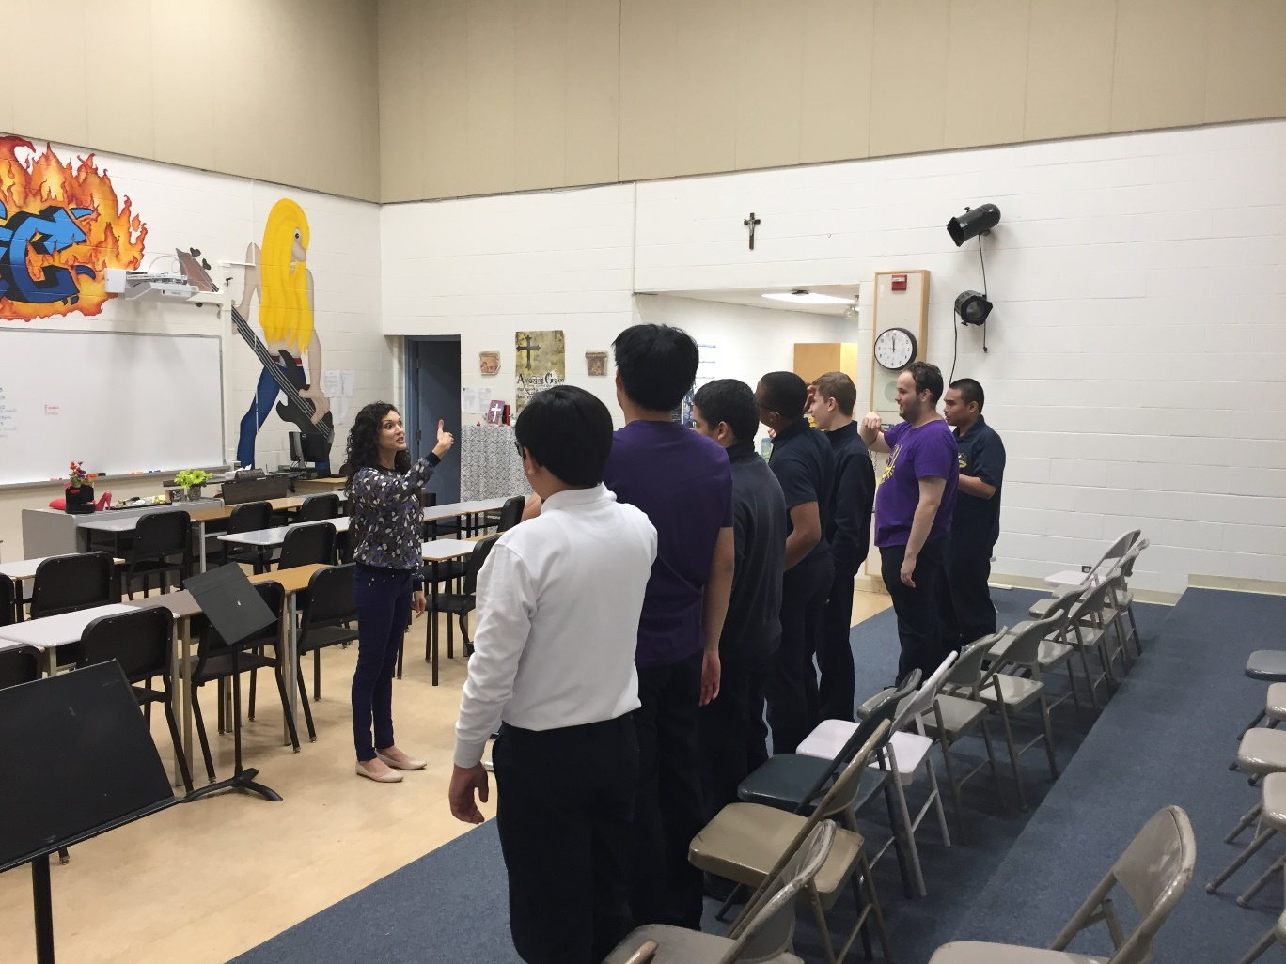
Caring Voices Practice with Solfege

Slide 10
Our Own Vocal Health
The Importance of taking care of OUR individual voice.
The Microphone benefits both the teacher and students
Using the Microphone while ear training

Slide 11
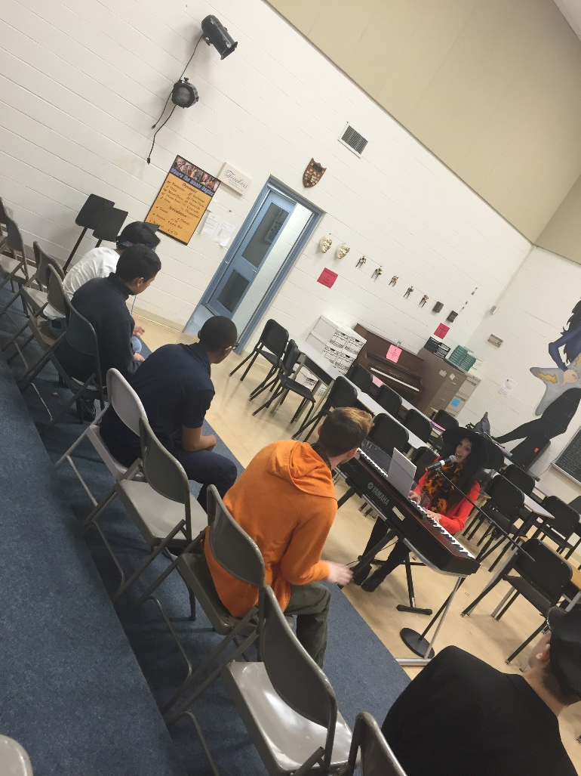
Voice Amplification Ideas

Slide 12
“Live” Music Lesson with Melanie*
Learning a Solo Song from “The Greatest Showman”
  Acting as a Vocal Mirror
  Demonstrating Some Vocal Techniques with the amazing Student and Singer Melanie Mallozzi
  * Due to health issues, there is a possibility that Melanie may not be able to attend.

Slide 13
Concert Time
Performance of “He Loves Us”
Words and Music by David Crowder Band
He is jealous for me
Loves like a hurricane, I am a tree
Bending beneath the weight of His wind and mercy
And all of a sudden
I am unaware of these afflictions eclipsed by glory
And I realize just how beautiful You are
And how great Your affections are for me
Oh, how He loves us, oh
Oh how He loves us
How He loves us all

Slide 14
Questions From Inspirational Awakeners
“Teachers have three loves: love of learning, love of learners, and the love of bringing the first two loves together.”
“We are not teachers, we are awakeners.”
Let us continue to awaken each other and our students.

Slide 15
Add a Slide Title - 5

Slide 16
Add a Slide Title - 6

