Slide 1
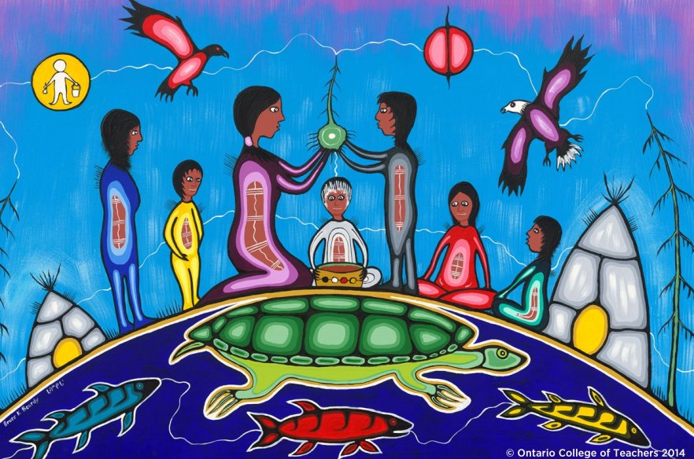
Exploring Indigenous Music in the Intermediate and Secondary Music Classroom
Presented by: Mary Ann Fratia
Opus 100: Ontario Music Educators’ Association Conference
Friday, November 8, 2019

Slide 2
Mary Ann Fratia
35 + years experience in public education: J/I/S Music, Head of Music & Arts/HPE Coordinator – Peel DSB, TDSB, Winnipeg, Manitoba
Music (P,J,I,S), P/J Dance, Educational Assessment, Integrated Arts Practicum Advisor : Faculties of Education York University, Ontario Tech University, MT program, OISE/UT
AQ/ABQ/Honour Specialist Facilitator: I/S Music, OISE/UT, York U
Education/Music Consultant: TVO Kids (Ping & Friends, Backyard Beats, The Wacky Word Show)
Curriculum Writer: York U, OISE/UT, MT program-OISE/UT
Workshop Presenter / Music Festival Adjudicator

Slide 3
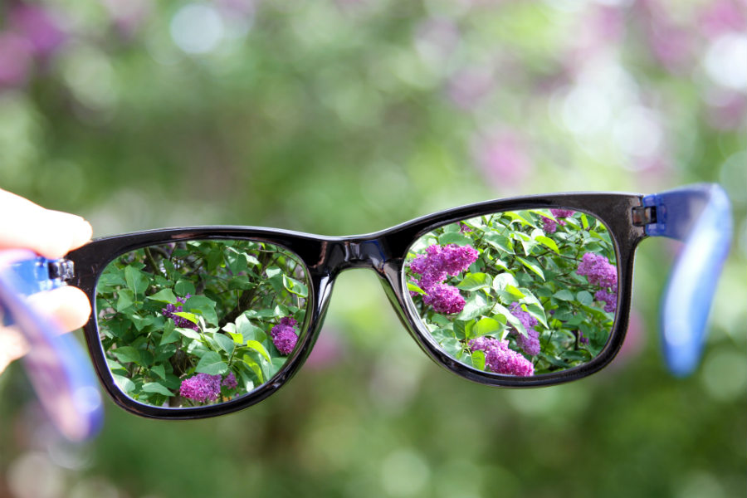
. . . The lens and context with which we share today. . .
I am not:
an Indigenous person / educator
an Elder
an expert on Indigenous culture, arts or music
I have committed to:
taking many workshops that are led by Elders, or other educators who worked with Elders and other Indigenous educators through OISE/UT, York University, Royal Ontario Museum in partnership with OISE/UT, Ontario Tech University, Native Canadian Center of Ontario
Teaching and learning about Indigenous music and addressing Ontario’s music curriculum expectations in a culturally relevant and respectful manner
Researching and learning as much as possible about Canada’s Indigenous music and arts through the use of authentic traditional and contemporary sources

Slide 4

1. the difference between appropriation and appreciation
both traditional and contemporary Indigenous music
through music focused listening activities
the critical analysis process through the use of the
elements of music
the creative process through soundscape composition
based on personal response to the concepts presented
in the medicine wheel using non-standard graphic
notation
(based on the activity from OISE/UT Deepening Knowledge website
written in partnership with the Native Canadian Center of Toronto with music
colleagues and with the consultation of Elder Jacqui’ Lavalley,
Edit: Cindilee ‘Little Eagle’ Ecker-Flagg)

Slide 5
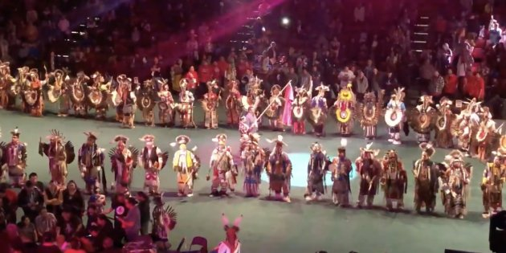
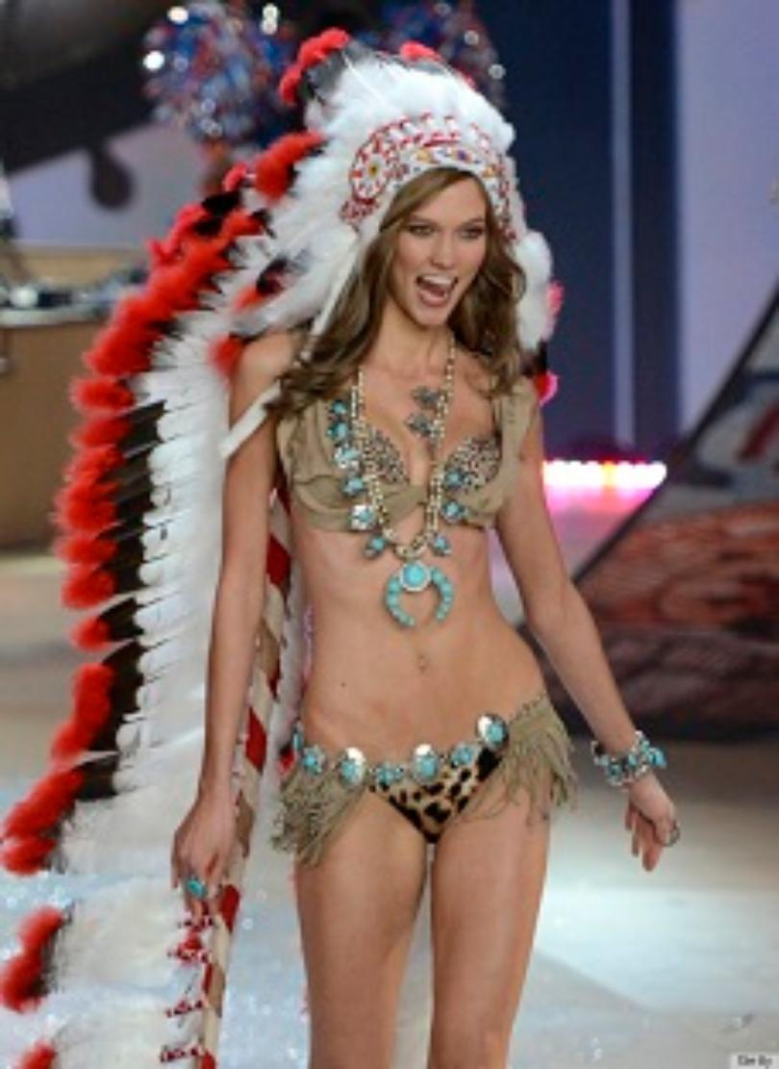
Appropriation or Appeciation?
What’s the difference? (see chart - handout)
Photo A Photo B

Slide 6

Cultural Appropriation
(on handout)
Cultural Appropriation is the adoption of elements of a minority culture by members of the dominant culture.
Because of the presence of power imbalances that are a byproduct of colonialism and oppression, cultural appropriation is distinct from equal cultural exchange.
Examples: culturally significant symbols, motifs used in non-Indigenous products,
marketing, arts, sports logos
Questions you must ask are:
Is the specific icon of another culture being used for the purpose in which it was intended?
2. Is this offensive to that particular culture?
3. Who is benefitting/profiting from the sharing of this item?
(An Indigenous composer? A Canadian or American music publisher?
An Indigenous artist? An Indigenous fashion designer?)

Slide 7
Cultural Appreciation
(this is where our music curriculum focus is required to be)
Cultural Appreciation is when elements of a culture are used while honoring the source they came from. Appreciation involves respect and value.
Inviting elders to come in and share their culture with you
Sharing key cultural learnings with respect and appreciation
Putting the learning (music) in it’s correct context
Is this musical work written by a Canadian Indigenous composer?
Does this piece reflect traditional Indigenous music-making traditions?
Does the performance of this work include traditional Indigenous
instruments?
Who makes money from the sale of this particular arrangement?
e.g. This musical composition uses some Canadian Indigenous music characteristics such
as descending melodic lines, interval jumps of a p4 & p5, steady beat & pulse

Slide 8
Appreciation
Photo A
Powwow dancers take to the floor in Edmonton, in a powerful tribute to missing and murdered Indigenous women and girls.
(HuffPost 10/01/2018)
On Sunday, a competition powwow was held to wrap up the event, with representatives from tribes across North America dressed in full regalia, dancing to win cash prizes.
But before the dancers took to the stage, organizers brought out a red dress, created by an Indigenous designer, hung high on a pole.
They then asked the male dancers to come onto the arena floor and form a circle around the woman holding the red dress — which is used as a symbol for missing and murdered Indigenous women and girls (MMIWG) in Canada — and close the gaps between them.
Then the men began to dance. Powwow dancers take to the floor in Edmonton, in a powerful tribute to missing and murdered Indigenous women and girls.

Slide 9
Appropriation
Photo B
Victoria's Secret Issues Apology for
Model’s Attire
(Associated Press, Nov. 12, 2013)
Feather headdresses are a symbol of bravery and are worn by Native American leaders in some tribes, including chiefs. Women don't wear headdresses.

Slide 10
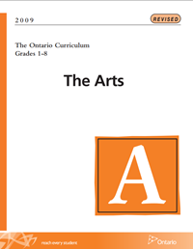


Slide 11
Connections to our Music Curriculum
Grade 7 Music (Specific Expectations)
Creating and Performing
C1.1 sing and/or play, in tune, from musical notation, unison music and music in two or more parts from diverse cultures, styles, and historical periods
Reflecting, Responding, Analyzing
C2.2 analyse, using musical terminology, ways in which the elements are used in the music that they perform, listen to, and create (e.g., compare the use of drums in different social and cultural contexts, such as Asian, Aboriginal, and African communities; describe how the use of the various elements affects their response to the music)
Exploring Forms and Cultural Contexts
C3.1 analyse the influences of music and the media on the development of personal and cultural identity (e.g., describe how their personal musical preferences have been formed from listening to music readily available in the media; explain how cultural identity, including a sense of Aboriginal pride for Aboriginal students, can be reinforced by listening to music of their own culture)

Slide 12
Connections to our Music Curriculum
Grade 8 Music (Specific Expectations)
Creating and Performing
C1.1 sing and/or play, in tune, music in unison and in two or more parts from a variety of cultures, styles, and historical periods
Reflecting, Responding, Analyzing
C2.2 analyse, using musical terminology, ways in which the elements of music are used in various styles and genres they perform, listen to, and create
Exploring Forms and Cultural Contexts
C3.1 analyse some of the social, political, and economic factors that affect the creation of music (e.g. historical events that inspired the composition of nationalistic music; the development of jazz, rap, and heavy metal, and their effect on culture; the social and/or cultural origins of folk songs, love songs, national anthems, and dance music; the economic purposes for commercial music played in stores; purposes and effects of Aboriginal activism through song)
C3.2 compare and contrast music from the past and present (e.g., differences and similarities between music from various cultures and contemporary fusion forms; similarities and differences between traditional Aboriginal music and music sung and played by contemporary Aboriginal musicians . . .)

Slide 13
Connections to the Secondary Music Curriculum (Overall Expectations) Course Codes and Focus Courses
Grade 9 (AMU 10) | Grade 10 (AMU 20) | Grade 11 (AMU 3M & AMU 30) | Grade 12 (AMU 4M & AMU 4E)
Creating & Performing A 1 The Creative Process A 2 The Elements of Music A 3 Techniques & Technologies | A. Creating & Performing A 1 The Creative Process A 2 The Elements of Music A 3 Techniques & Technologies | A. Creating & Performing A 1 The Creative Process A 2 The Elements of Music A 3 Techniques & Technologies | A. Creating & Performing A 1 The Creative Process A 2 The Elements of Music A 3 Techniques & Technologies
B. Reflecting, Responding & Analyzing B 1 The Critical Analysis Process B2 Music & Society | . Reflecting, Responding & Analyzing B 1 The Critical Analysis Process B2 Music & Society | . Reflecting, Responding & Analyzing B 1 The Critical Analysis Process B2 Music & Society B4 Connections Beyond The Classroom | Reflecting, Responding & Analyzing B 1 The Critical Analysis Process B2 Music & Society B3 Skills & Personal Growth B4 Connections Beyond The Classroom
C. Foundations C1 Theory & Terminology C2 Characteristics and Development of Music C3 Conventions & Responsible Practices | C. Foundations C1 Theory & Terminology C2 Characteristics and Development of Music C3 Conventions & Responsible Practices | C. Foundations C1 Theory & Terminology C2 Characteristics and Development of Music C3 Conventions & Responsible Practices | . Foundations C1 Theory & Terminology C2 Characteristics and Development of Music C3 Conventions & Responsible Practices
AMC Music for Creating AMQ Steel Pan Music
AMM Music & Computers AMP Instr. – Percussion
AMV Vocal Choral AME Small Ensemble
AMD Electronic Music

Slide 14
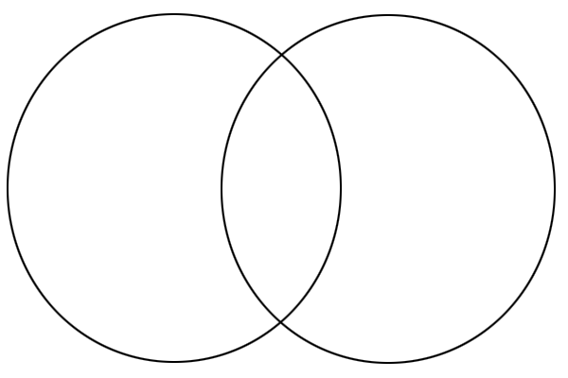
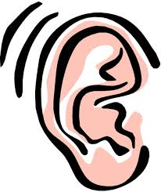
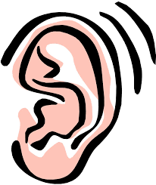
Step 1: Active Listening with a Focus
(Diagnostic – Assessment ‘for’ Learning)
Selection 1 Selection 2

Slide 15
Active Listening – Listening with a Focus
Selection 1: Squamish Nation Pow Wow 2011 FULL REGALIA
First Nations Native Dance in Vancouver
https://www.youtube.com/watch?v=TcnA5nUNSE4
Selection 2: A Tribe Called Red - Electric Pow Wow Drum
https://www.youtube.com/watch?v=lpkUISUx3Lo

Slide 16
Let’s Listen to Selection #2
Let’s listen to Selection #2
again, more critically
this time, using the
Elements of Music (7) chart.
Check off the boxes that apply.

Slide 17
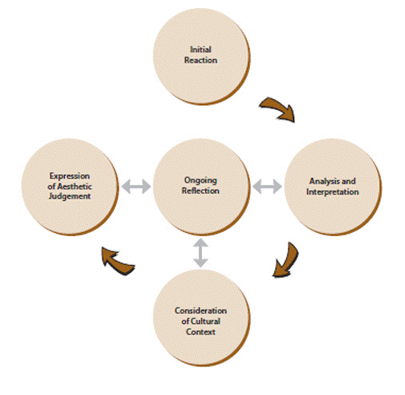

Step 2: Active Listening ~The Critical Analysis Process

Slide 18
Active Listening – The Critical Analysis Process
Musicians | Website
The Stranger Official Video | The Secret Path (Gord Downie) (Intro-Minds On) Chanie Wenjack (Residential Schools) https://www.youtube.com/watch?v=za2VzjkwtFc
First Nations Morningstar River Singers (and Dancers) 5 min | Authentic Traditional and Contemporary Indigenous Music Native Drums website (Intro – Minds On) http://www.native-drums.ca/index.php/Video/?tp=a&bg=1&In=e
The Making of an Ojibway Hand Drum (4 min) | Native Drums website (Intro - Minds On) http://www.native-drums.ca/index.php/Video/?tp=a&bg=1&In=e
Odawa Jingle Dance performance (1 min) | Native Dance website (Intro-Minds On) http://www.native-dance.ca/
Buffy Ste. Marie (Cree) Drezus (Plains-Cree) | Bury My Heart at Wounded Knee https://www.youtube.com/watch?v=eTmvrHoyMZ8 Red Winter (Idle No More) https://www.youtube.com/watch?v=VEc3ZYqi5Fw
Most All that I Know (Oji-Cree-Meti) | Contemporary https://www.youtube.com/watch?v=5VAF3ypMS84
David Maracle (Tyendinaga Mohawk) | Native Flute https://www.youtube.com/watch?v=JpLFD0eNTQ8&feature=youtu.be
A Tribe called Red (Ojibway, Cayuga, Mohawk) | Black Bear- Stadium Pow Wow – Official Video “We are the Halluci Nation” https://www.youtube.com/watch?v=eAEmjW9J3_o

Slide 19

Red Winter Lyrics
Verse
My skin’s red, I bleed red, I’m seeing red
I’m praying for my people out there who ain’t seen it yet
His blood is cold, he’s living lies forever told
By his ancestors 500 years ago
Yeah I said it, got my peoples getting restless
Making money off our land and we ain’t even on the guest list
Carry on traditions of a racist ass pilgrim
And I know you really love it when my people play the victim
‘Cause it makes it seem like we’re folding under pressure
But we up to bat now no more playing catcher
‘Cause we see the bigger the picture that we have to capture
See how quick we get together? Man, we out to get ya
Chorus
You can lock us in jail and throw away the key
Take away my rights but you ain’t stopping me
‘Cause I been quiet for too long its time to speak
We got to stand for something to keep us free!
I’m idle no more
I’m idle no more
I’m idle no more
Yeah I’m idle no more

Slide 20
The Critical Analysis Process: DREZUS – Red Winter
Initial Reaction What is your initial reaction to the lyrics of this piece? To the video?
Description List everything you hear in this music (voices, instrumentation, style/genre) and/or in the video.
Analysis How were the elements of music (melody, rhythm, harmony, timbre, texture, form, dynamics) organized and manipulated? Do you think this was effective? Why/why not? What are the lyrics expressing? What social justice/equity issue is it exploring? | Melody: Rhythm: Harmony: Timbre: Texture Form: Dynamics:
Consideration of Cultural Context What’s the cultural context of this music and the lyrics? What connections does it make to the time in which it was written? Is it still culturally relevant and meaningful today? How?
Informed Point of View What is your overall opinion of this musical work? Did it change at all from your initial reaction? Why/why not?

Slide 21
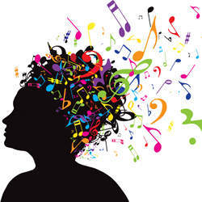
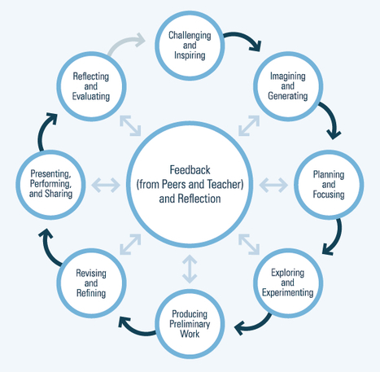
Step 3: Soundscape Composition ~ The Creative Process (based on Deepening Knowledge website activity: OISE/UT & Native Canadian Centre of Toronto – 5 pages in the booklet)

Slide 22
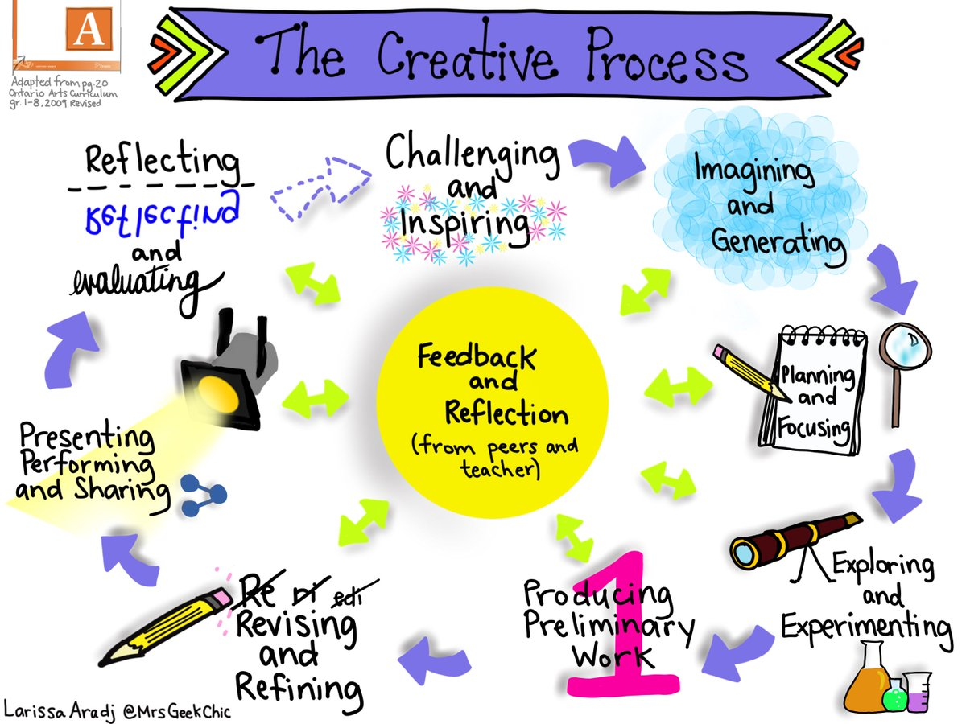

Slide 23

What do we know about the Medicine Wheel ?

Slide 24
The Medicine Wheel (see lesson plan in package)
The symbol of a circle is a symbol that exists on all continents
First Nations, Metis and Inuit people of Turtle Island have their own unique views of the circle
The Medicine Wheel teaching can vary from one nation to another
This lesson provides a glimpse of the Anishinaabe view of the wheel
Part of the natural order of creation, the four directions, the four seasons, the four times of day, the four periods of life (cycle of birth and death) and the four aspects of self
It represents continuous movement through each cycle, leading to greater and deeper understanding
It represents the relationships between aspects of the self, the world and life

Slide 25
The Medicine Wheel
North, Winter, Night, Elder,
Emotional (Heart)
West, Autumn, Sunset East, Spring, Morning,
Adult, Physical (Body) Child, Spiritual (Spirit)
South, Summer, Midday
Youth, Mental (Mind)

Slide 26
The Medicine Wheel
Let’s all face EAST
Close your eyes… what sounds might you hear in the East?
What sounds might you imagine hearing in the Spring? In the Morning? In childhood?
How might we create those sounds using our bodies (voice, body percussion), found sounds
and with any percussion sounds that are available to us today?
East, Spring, Morning,
Child, Spiritual (Spirit)

Slide 27
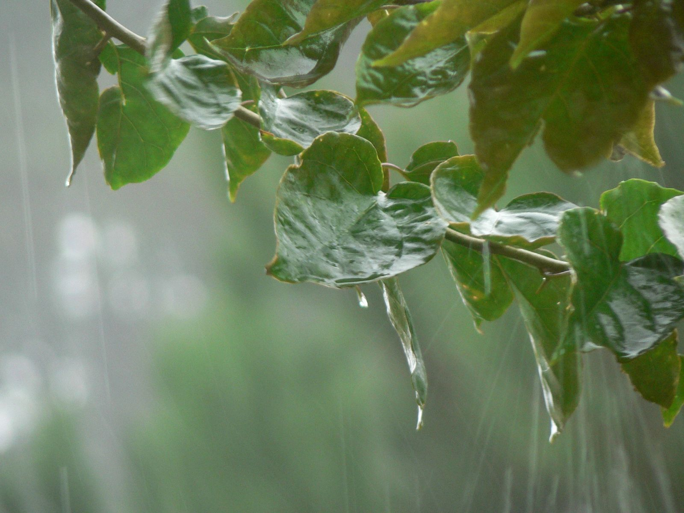

Slide 28


Slide 29
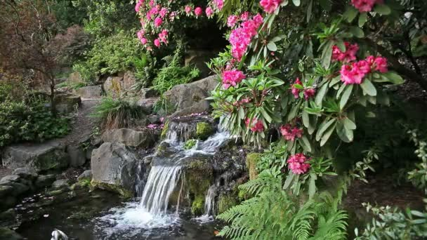

Slide 30
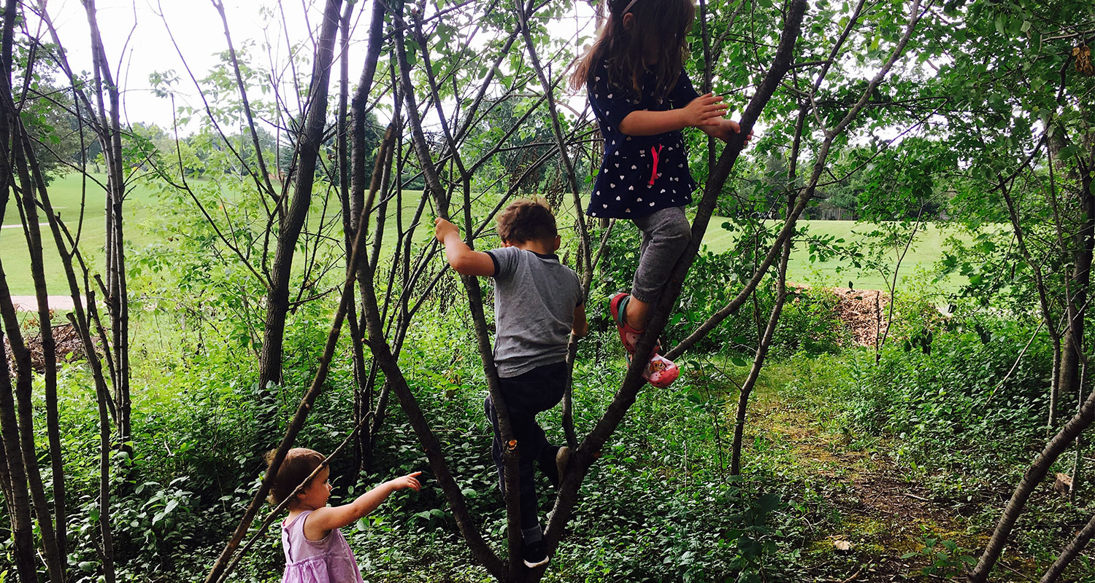

Slide 31


Slide 32
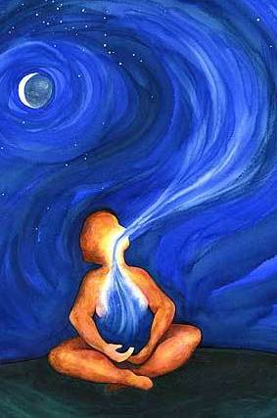

Slide 33
The Medicine Wheel
In groups of 8-10 (ideal group size is 4-6) you will compose a soundscape that is approximately 45-60 seconds long (because of time) to reflect the sounds you imagine as you try to represent your quadrant of the medicine wheel. You can use vocal sounds, body percussion, found sounds, or any percussion type instrument to imitate the sounds your imagination hears.
You will have 15 minutes to compose your
composition as you travel through the
various stages of the Creative Process.
Notate your composition using non
-standard Graphic Notation. We will then
listen to every group’s composition in the
cycle of life - East, South, West and North.

Slide 34
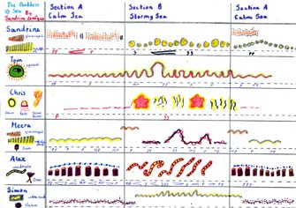
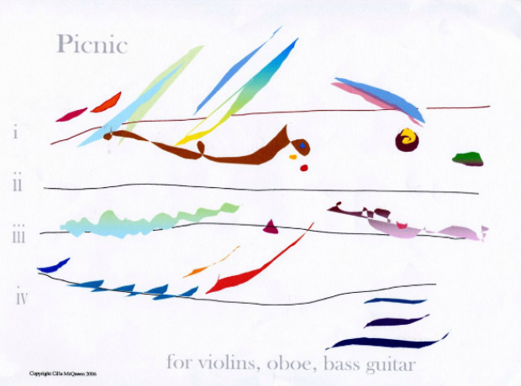
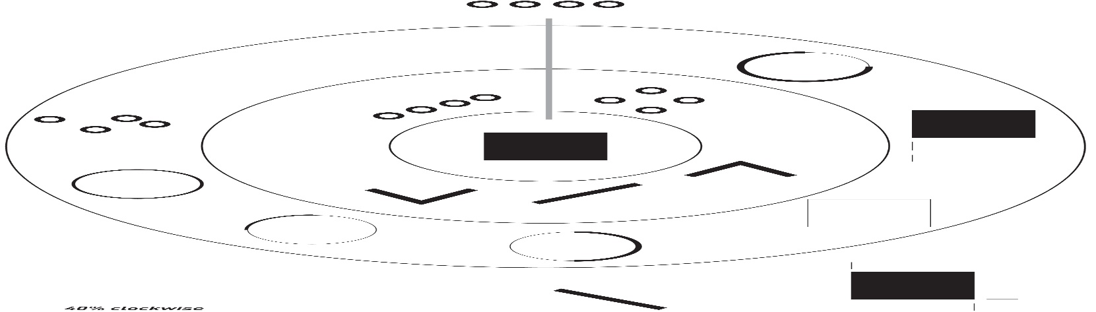
Graphic Notation

Slide 35
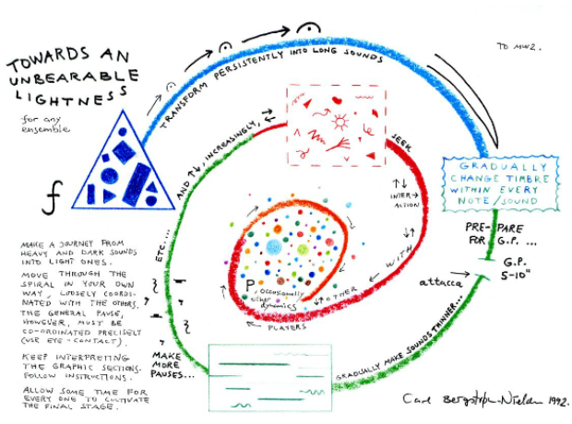

Slide 36
Soundscape: Success Criteria Checklist
Assessment ‘for’ Learning
Our Soundscape composition:
followed the Creative Process (Challenging, Imagining/Generating, Planning/Focusing, Exploring/
Experimenting, Producing Preliminary Work, Revising/Refining, Presenting/Performing, Reflecting/Evaluating)
has a beginning, middle, and end
used various instrumental timbres
used vocal timbres
used found or environmental timbres
used body percussion timbres
used a variety of soft and loud dynamics (piano and forte dynamics)
used a variety of slow and fast tempos (adagio and allegro tempi)
clearly communicated an idea, message, concept, feeling or mood
used musical sounds that fit the meaning of one of the parts of the Medicine Wheel
used non-traditional graphic notation on our score
had a clear legend (symbols and their representative sounds)
was performed well and was prepared

Slide 37
Soundscape: Success Criteria Checklist
Assessment ‘for’ Learning
The soundscape is about ______________________________________
The mood we tried to create is ___________________________________
The instruments we chose to create this mood were ______________________________________________________________
We chose them because ______________________________________________________________
It reminds us of________________________________________________
It makes us feel _______________________________________________

Slide 38
Soundscape: Assessment ‘of’ Learning Rubric
Criteria | Level 1 | Level 2 | Level 3 | Level 4 | Level 4+
followed the creative process (Challenging, Imagining/Generating to Reflecting/Evaluating) | No stages of the creative process were followed | Few of the stages of the creative process were followed | Some of the stages of the creative process were followed | Most stages of the creative process were followed | All stages of the creative process were followed
used a variety of timbres | No timbres were used were used effectively | Very few timbres were used effectively | Some various timbres were used effectively | A wide variety of timbres were used effectively | An extremely wide variety of timbres were used very effectively
used a variety of soft and loud dynamics (piano and forte dynamics) | No dynamics were used in the soundscape | Very few dynamics were used effectively | Some dynamics were used effectively | A variety of dynamics were used effectively | A wide variety of dynamics were used very effectively
used a variety of slow and fast tempos (adagio and allegro tempi) | No variety in tempos were evident in the soundscape | Some tempos were evident in the soundscape and used somewhat effectively | Some tempos were evident in the soundscape and used effectively | Numerous tempos were evident in the soundscape but note used very effectively | Numerous tempos were evident in the soundscape and used very effectively
clearly communicated an idea, message, feeling , concept or mood | The soundscape did not communicate an idea, message, feeling, concept or mood | The soundscape communicated an idea, message, feeling, concept or mood occasionally | The soundscape communicated an idea, message, concept or mood | The soundscape clearly communicated an idea, message, feeling, concept or mood effectively | The soundscape very clearly communicated an idea, message, feeling, concept or mood very effectively

Slide 39

Let’s get Creative! Soundscape Composition based on the Medicine Wheel

Slide 40
Our Performance
North, Winter, Night, Elder,
Emotional (Heart)
West, Autumn, Sunset East, Spring, Morning,
Adult, Physical (Body) Child, Spiritual (Spirit)
South, Summer, Midday
Youth, Mental (Mind)

Slide 41
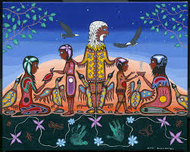
Indigenous Music & Education Resources
Ontario College of Teachers: Ethical Standards ~ TRUST
Bruce Beardy (OjiCree Artist)

Slide 42

maryann.fratia@utoronto.ca
mafratia@edu.yorku.ca
maryann.fratia@ontariotechu.ca
maryann.fratia@gmail.com

